Slide 1
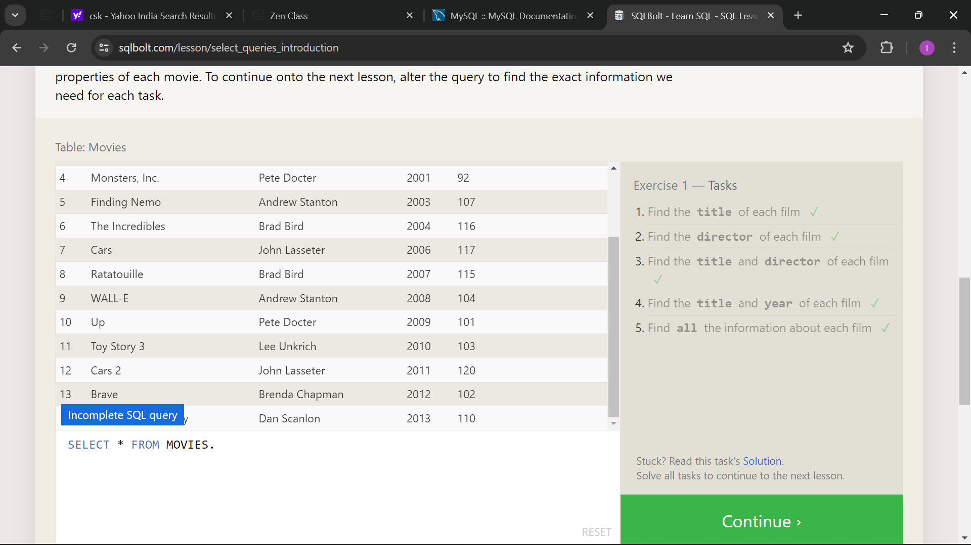
SQL Lesson 1: SELECT querise 101

Slide 2
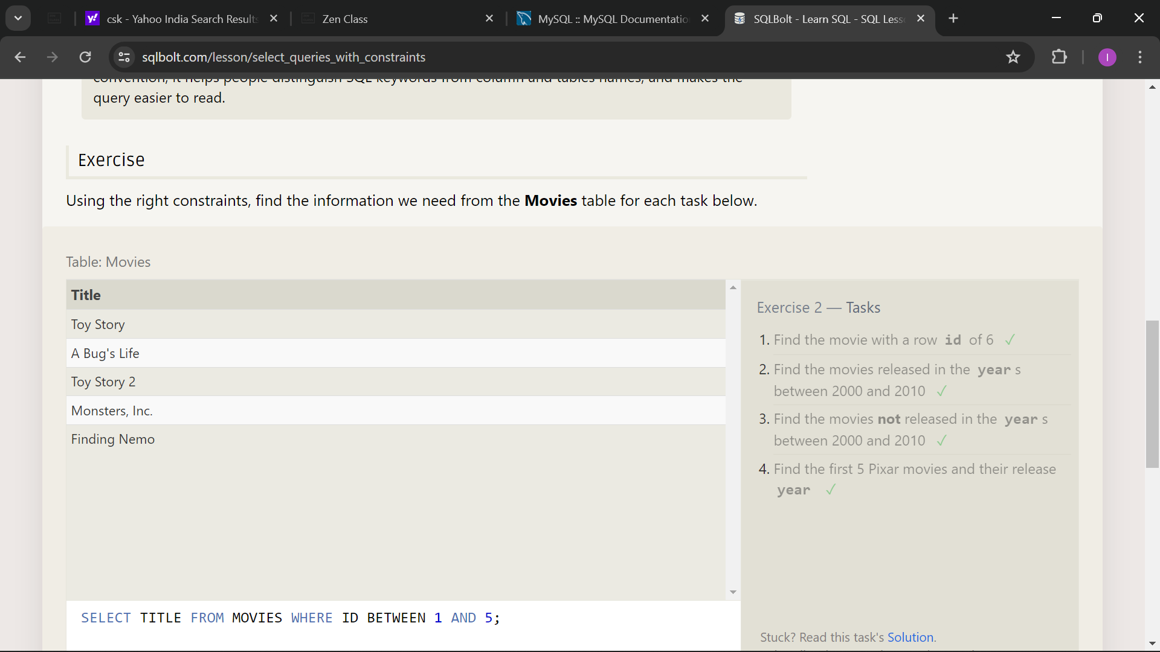
SQL Lesson 2: Queries with constraints (Pt. 1)

Slide 3
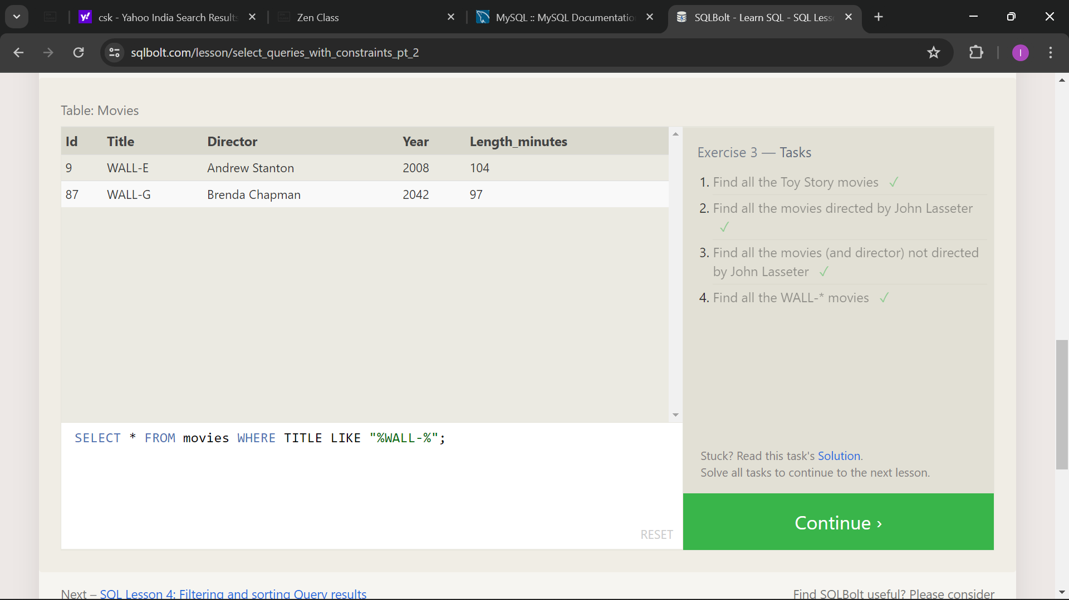
SQL Lesson 3: Queries with constraints (Pt. 2)

Slide 4
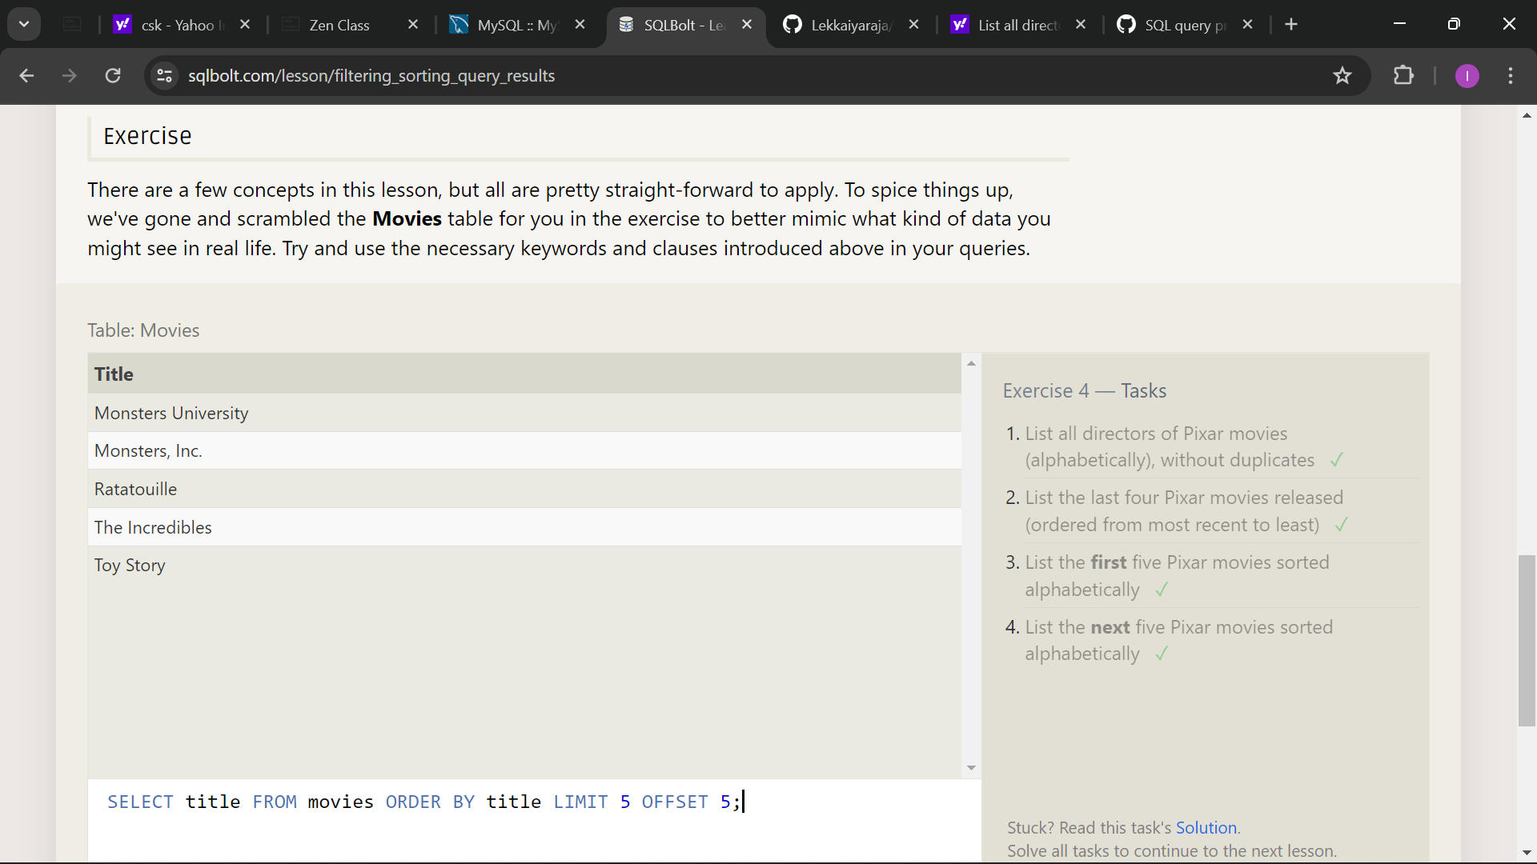
SQL Lesson 4: Filtering and sorting Query results

Slide 5
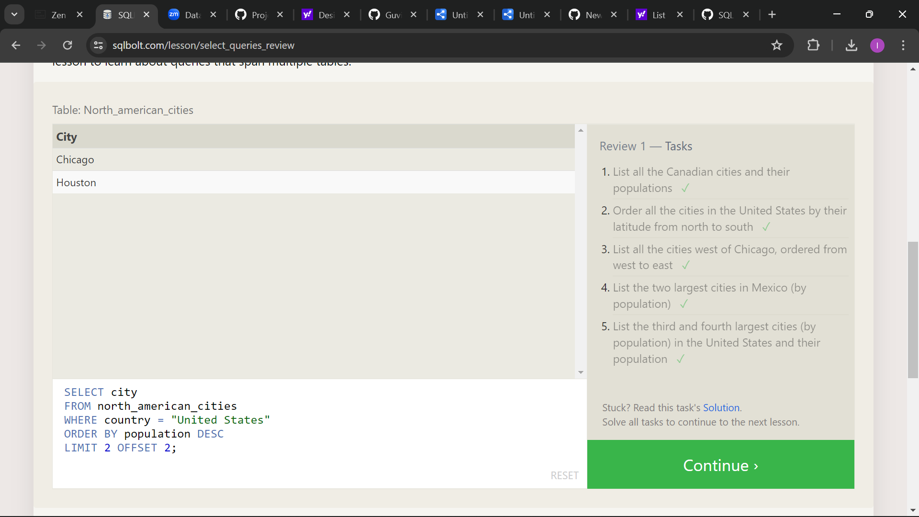
SQL Review: Simple SELECT Queries

